Slide 1

Introduction to Decision Tree
Mathematics Behind Decision Tree – Detailed Understanding

Slide 2
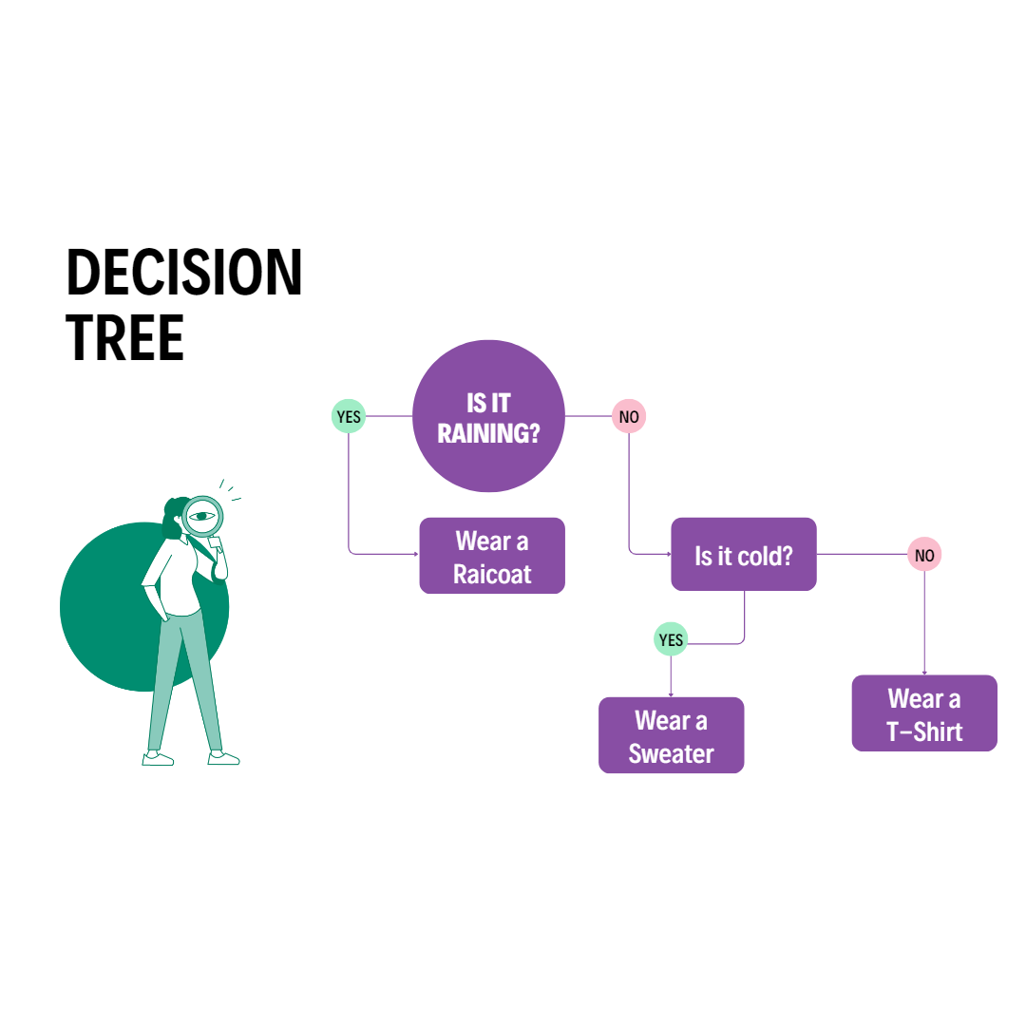
What is Decision Trees?
A decision tree is like a flowchart that helps you make decisions by asking a series of questions. Imagine you're trying to decide what to wear today.
In simple terms, a decision tree helps break down complex choices into a series of smaller, easier decisions, guiding you step by step to the best choice based on the information you have.

Slide 3
Decision Tree Classification
A decision tree for classification is a model used to predict the category or label of a given input. It's like a series of questions that guide you to a final decision.
Start with a Question: The tree begins with a root node, which asks the most important question about the data. For example, if you're trying to classify whether an email is spam or not, the first question might be, "Does the email contain the word 'discount’?”
Branch Out: Based on the answer (yes or no), the tree branches out into different nodes, each asking another question or making a decision. Each branch represents a possible outcome of the question, leading to further questions or decisions.

Slide 4
Decision Tree Classification
Leaf Nodes: Eventually, you reach a leaf node, which is the final decision or classification. In the email example, a leaf node might say, "This is spam" or "This is not spam."
Goal: The goal is to classify the data accurately by answering the questions in the tree. The tree is built in such a way that it splits the data based on features that provide the most information, leading to the most accurate classification.

Slide 5
Decision Tree Regression
A decision tree for regression is used to predict a continuous value, like predicting the price of a house or the temperature on a given day.
Start with a Question: Similar to classification, the regression tree begins with a question, but instead of splitting the data into categories, it splits the data into ranges of values. For example, if predicting house prices, the first question might be, "Is the house area greater than 2000 square feet?"
Branch Out: Each branch leads to further questions that help narrow down the range of values. For instance, if the answer is "yes," the next question might be, "Is the number of bedrooms greater than 3?"

Slide 6
Decision Tree Regression
Leaf Nodes: In regression, the leaf nodes represent the predicted value. Instead of saying "spam" or "not spam," it might predict, "The house price is $350,000."
Goal: The goal is to make the most accurate prediction by breaking down the data into smaller and smaller ranges, using questions that minimize the difference between the predicted values and the actual values.

Slide 7
Decision Tree Regression
Leaf Nodes: In regression, the leaf nodes represent the predicted value. Instead of saying "spam" or "not spam," it might predict, "The house price is $350,000."
Goal: The goal is to make the most accurate prediction by breaking down the data into smaller and smaller ranges, using questions that minimize the difference between the predicted values and the actual values.

Slide 8
Final Decision Tree
Outlook
Sunny
Overcast
Rainy
Humidity
Yes
Windy
High
Normal
Weak
Strong
No
Yes
Yes
No

Slide 9
Decision Tree Hands On in Python

Slide 10
Advantages of Decision Trees
Easy to Understand and Interpret:
Decision trees are intuitive and easy to explain to others, even those without a strong background in data science. The visual representation (a tree structure) is simple to follow and interpret.
No Need for Feature Scaling:
Decision trees do not require the data to be scaled or normalized. They are not affected by the magnitude of the features, unlike algorithms like SVMs or linear regression.
Handles Both Numerical and Categorical Data:
Decision trees can handle both numerical and categorical variables without requiring any preprocessing, such as one-hot encoding.
Captures Non-linear Relationships:
Decision trees can capture complex relationships between features and the target variable, including non-linear patterns.

Slide 11
Advantages of Decision Trees
Handles Multi-output Problems:
Decision trees can handle problems where multiple outputs are required. They can be extended to handle multi-output tasks naturally.
Feature Importance:
Decision trees provide a clear indication of which features are most important for prediction, which can be insightful for understanding the data.
Requires Less Data Preparation:
Decision trees require minimal data preparation compared to other algorithms, such as the need for dummy variables or standardization.

Slide 12
Disadvantages of Decision Trees
Overfitting:
Decision trees are prone to overfitting, especially when they grow too deep. They can learn the noise in the data rather than the actual patterns, leading to poor generalization on new data.
Sensitive to Small Variations in Data:
Small changes in the data can lead to entirely different tree structures, making them unstable. This sensitivity can be mitigated by using techniques like bagging or random forests.
Biased Towards Dominant Classes:
If the data is imbalanced, decision trees may become biased towards the dominant class, leading to skewed results. Techniques such as cost-sensitive learning or resampling can help address this issue.

Slide 13
Disadvantages of Decision Trees
Greedy Nature:
The greedy nature of decision trees (splitting nodes based on the best immediate split) might not result in the globally optimal tree. Sometimes, a better split might be found further down the tree.
Not Well-suited for Very Large Datasets:
While decision trees can handle large datasets, they are not as efficient as some other algorithms (like random forests or gradient boosting) in terms of both memory and computational time, especially when the dataset is very large.
Poor Performance on Unseen Data:
Without proper pruning or ensemble methods, decision trees often perform poorly on unseen data due to overfitting.
Complex Trees are Hard to Interpret:
While simple trees are easy to interpret, very complex trees with many levels can become difficult to understand and interpret.

Slide 14
Practical Applications of Decision Trees

Slide 15
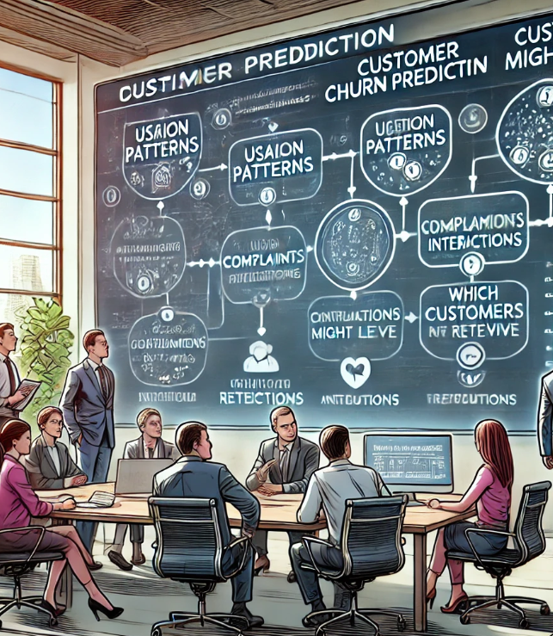
Customer Relationship Management (CRM)
Customer Segmentation: Decision trees are used to segment customers based on various attributes such as purchasing behavior, demographics, and interactions, enabling personalized marketing strategies.
Churn Prediction: Companies use decision trees to predict which customers are likely to leave (churn) based on their usage patterns, complaints, or interactions with the company.

Slide 16

Insurance
Risk Assessment: Decision trees assist in assessing risks associated with insurance policies by analyzing customer data, claims history, and other relevant factors.
Fraud Detection: Similar to banking, they are used to detect fraudulent claims by identifying patterns in the claims data.

